Slide 1


A Quantum Optimisation Strategy for Scheduling Logistics Operations (The Resupply Problem)
Tavis Bennett

Slide 2
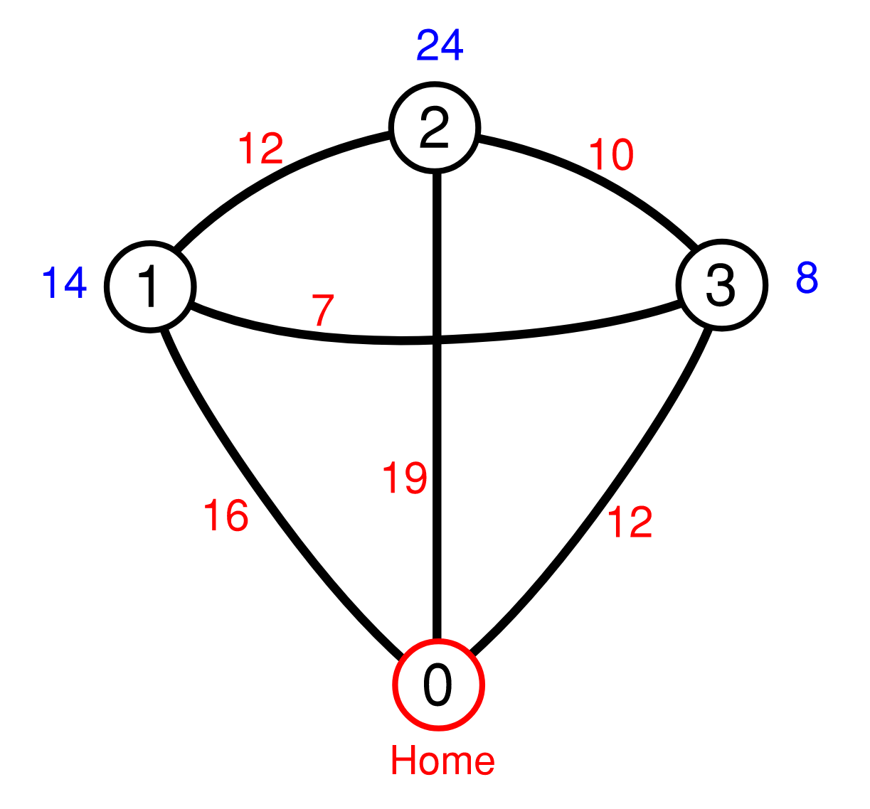
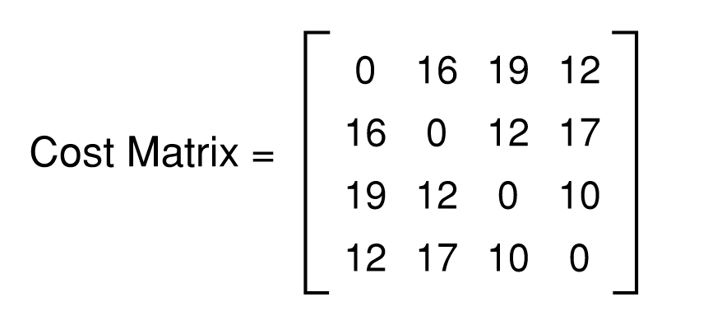
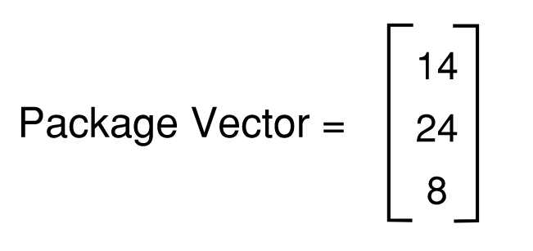
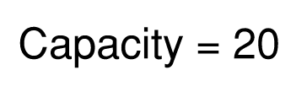
Defining the Problem

Slide 3
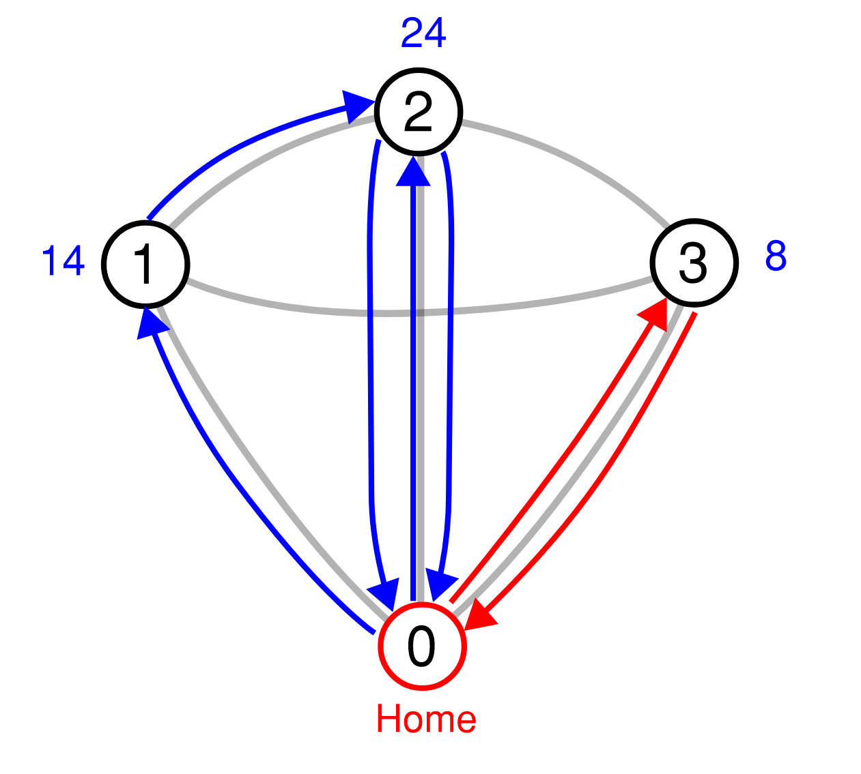

Example Solution
Solution represened by the set of ordered subsets: (1, 2), (3)
Order of subsets does not matter,
(1, 2), (3) $≡$ (3), (1, 2)
Notes:
Since this is a small problem, maybe we can come up with a fairly good solution by just working through it.
So lets start by making a delivery to node (1).
We deliver all 14 packages and we have 6 left
It makes sense to take these leftover packages to node (2), since node (2) can't be completed in one run anyway.
Conversely, It wouldn't make much sense to take the leftover packages to node (3), as that location requires 8 packages.
So we go to node (2), deliver the remaining 6 packages on the vehicle, return home, restock, come back to (2), deliver all the remaining required packages.
We only have 2 packages left, not enough to complete the third node, so we return home to restock. Then we complete the delivery to (3).
This particular solution is represented by the set of ordered subsets (1, 2) and (3).
The 1 and 2 are grouped together because the vehicle took the leftover packages from node (1) directly to node (2).
The 3 is in a separate group because despite having left over-packages on-board, a decision was made to return home for a restock before delivering to node (3).
Also take note of the fact that the two delivery groups are independent of each other. The red delivery could have happened prior to the blue delivery without effecting the delivery cost. So this means the ordering of groups or subsets does not matter, only the order of the nodes within the subsets.

Slide 4
Full Solution Space
A partition of a set is a grouping of all of its elements into non-empty subsets, such that every element is included in exactly one subset.
All solutions
All partitions
(1, 2, 3)
(1, 3, 2)
(2, 1, 3)
(2, 3, 1)
(3, 1, 2)
(3, 2, 1)
(1, 2), (3)
(2, 1), (3)
(1, 3), (2)
(3, 1), (2)
(1), (2, 3)
(1), (3, 2)
(1), (2), (3)
Original set
(1, 2, 3)
(1, 2), (3)
(1, 3), (2)
(1), (2, 3)
(1), (2), (3)
(1, 2, 3)
Partitioning
Permutation
Notes:
So to arrive at the full solution space, we must first find all partitions of the nodes into separate delivery groups or subsets, and then for each of these subsets we must create all possible permutations.
I’ve included a definition here of partitions, though it’s meaning probably becomes quite clear when you look at this example.
So for our simple 3 node example, we end up with 13 distinct solutions.
QUESTIONS??
As discussed previously by Sam, in order to be able to make use of the QWOA algorithm (quantum walk optimisation algorithm), we must be able to index the solution space.
I.e. for any arbitrary solution, we should be able to determine its index in a repeatable and efficiently computable manner, without simply creating the full solution space and seeing at which location it appears. We also need to be able to unindex, so if given an index, we need to be able to determine the solution it corresponds to.
To do this we make use of decision trees. First I'll discuss the partition tree.

Slide 5
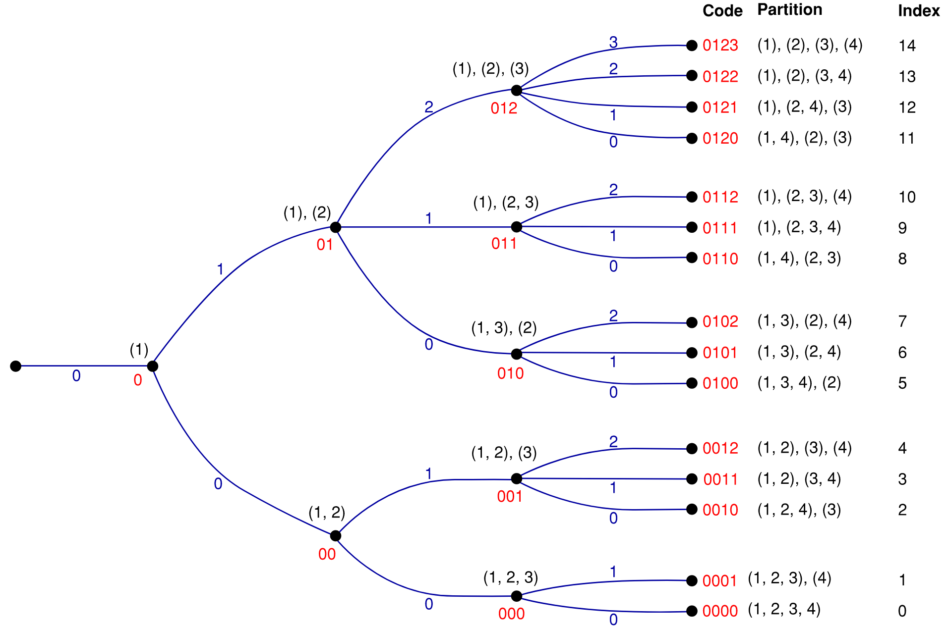
Partition Tree
Notes:
Each decision involves the placement of elements 1 to 4 into subsets.
The first decision is obvious, the element must be placed into a group by itself, we number this group 0.
The next decision is where to place the element 2… It can go in group 0 with the 1, or it can go in group 1 by itself. and so on.
Each branch in the tree represents a choice, and each of these branches is numbered accordingly from 0 upwards – where the branch number corresponds to the group the element was placed into.
Each node in the tree is labelled by a unique code which is a sequence of the choices/branches taken to reach that node.
the index of any particular partition becomes obvious when we layout the tree like this, but more formally:
the index of a partition is the number of nodes of equal depth which exist below it in the tree.
Below meaning with a smaller code, and depth being the number of decisions made to reach a node (or the length of the code at that point).
Questions??
Now we’ll discuss the permutation tree.

Slide 6
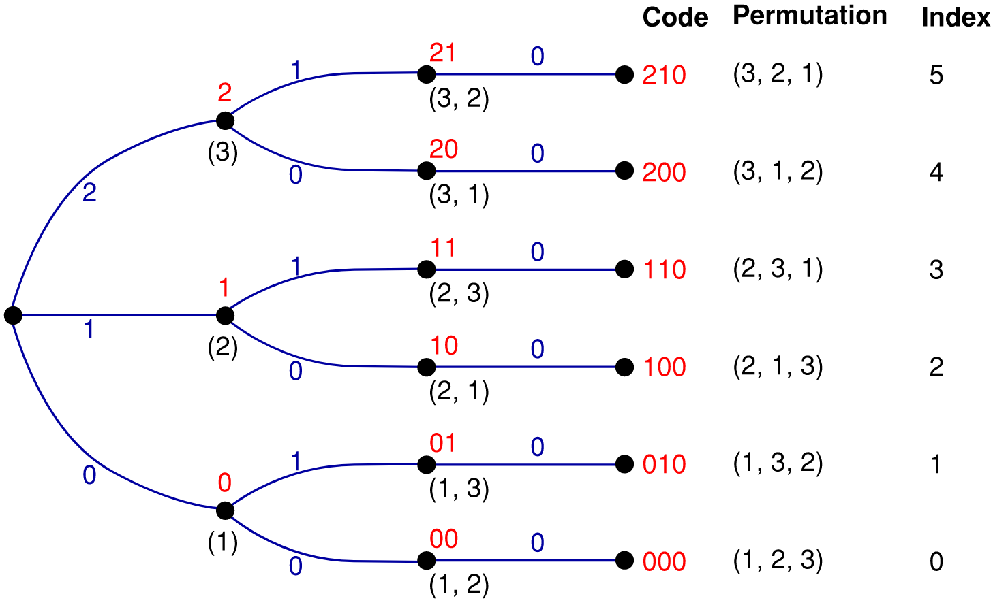
Permutation Tree
Notes:
To make sense of the permutation tree, we must establish an order to the elements. The order in this case is fairly intuitive, we'll take it to be ascending order.
Note that the subsets created from the partitioning process will always appear in ascending order.
as with the partition tree, each branch represents a decision, in this case it’s specifically which element is selected next in the permutation.
the zero branch represents the placement of the lowest order item next, of those items remaining for selection.
the 1 branch represents the placement of the second lowest order item, and so on.
The structure of this tree is much simpler than the partition tree, as the composition downstream of each branch is identical.

Slide 7
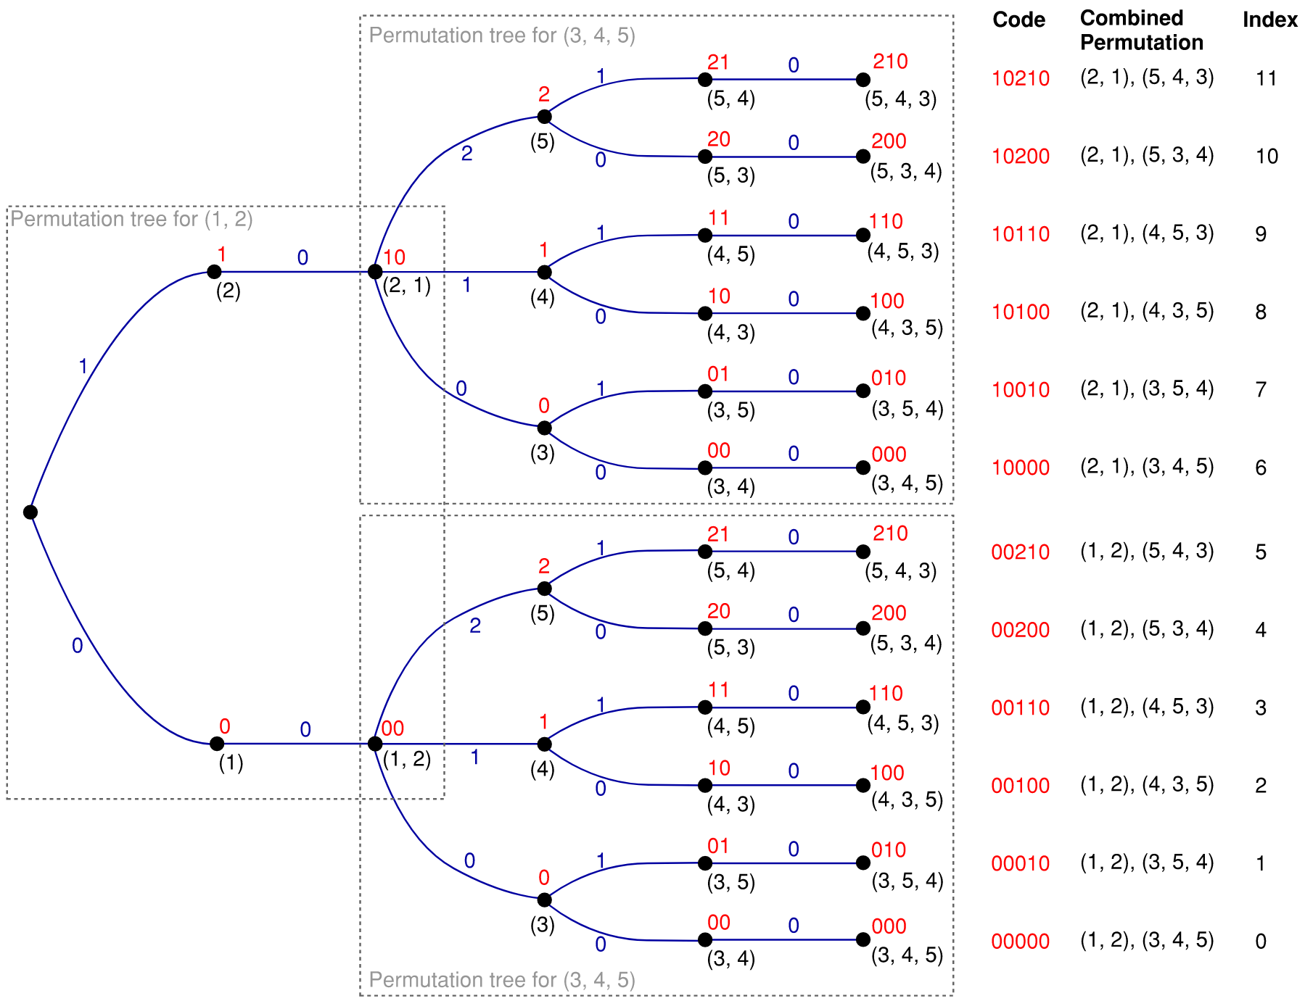
Combined Permutation Tree
This particular example is for the set of subsets: (1, 2), (3, 4, 5)
Notes:
Things get perhaps a little more complicated when we have multiple subsets. Take the example above, (1, 2) and (3, 4, 5).
The solution however is quite simple, we just perform the decisions for the first subset, then follow this with the decisions for the next subset, and so on.
We end up with two the two permutation trees nested together in this fashion
The codes end up just being merged together, as that is the full string of decisions made to create any particular combined permutation

Slide 8
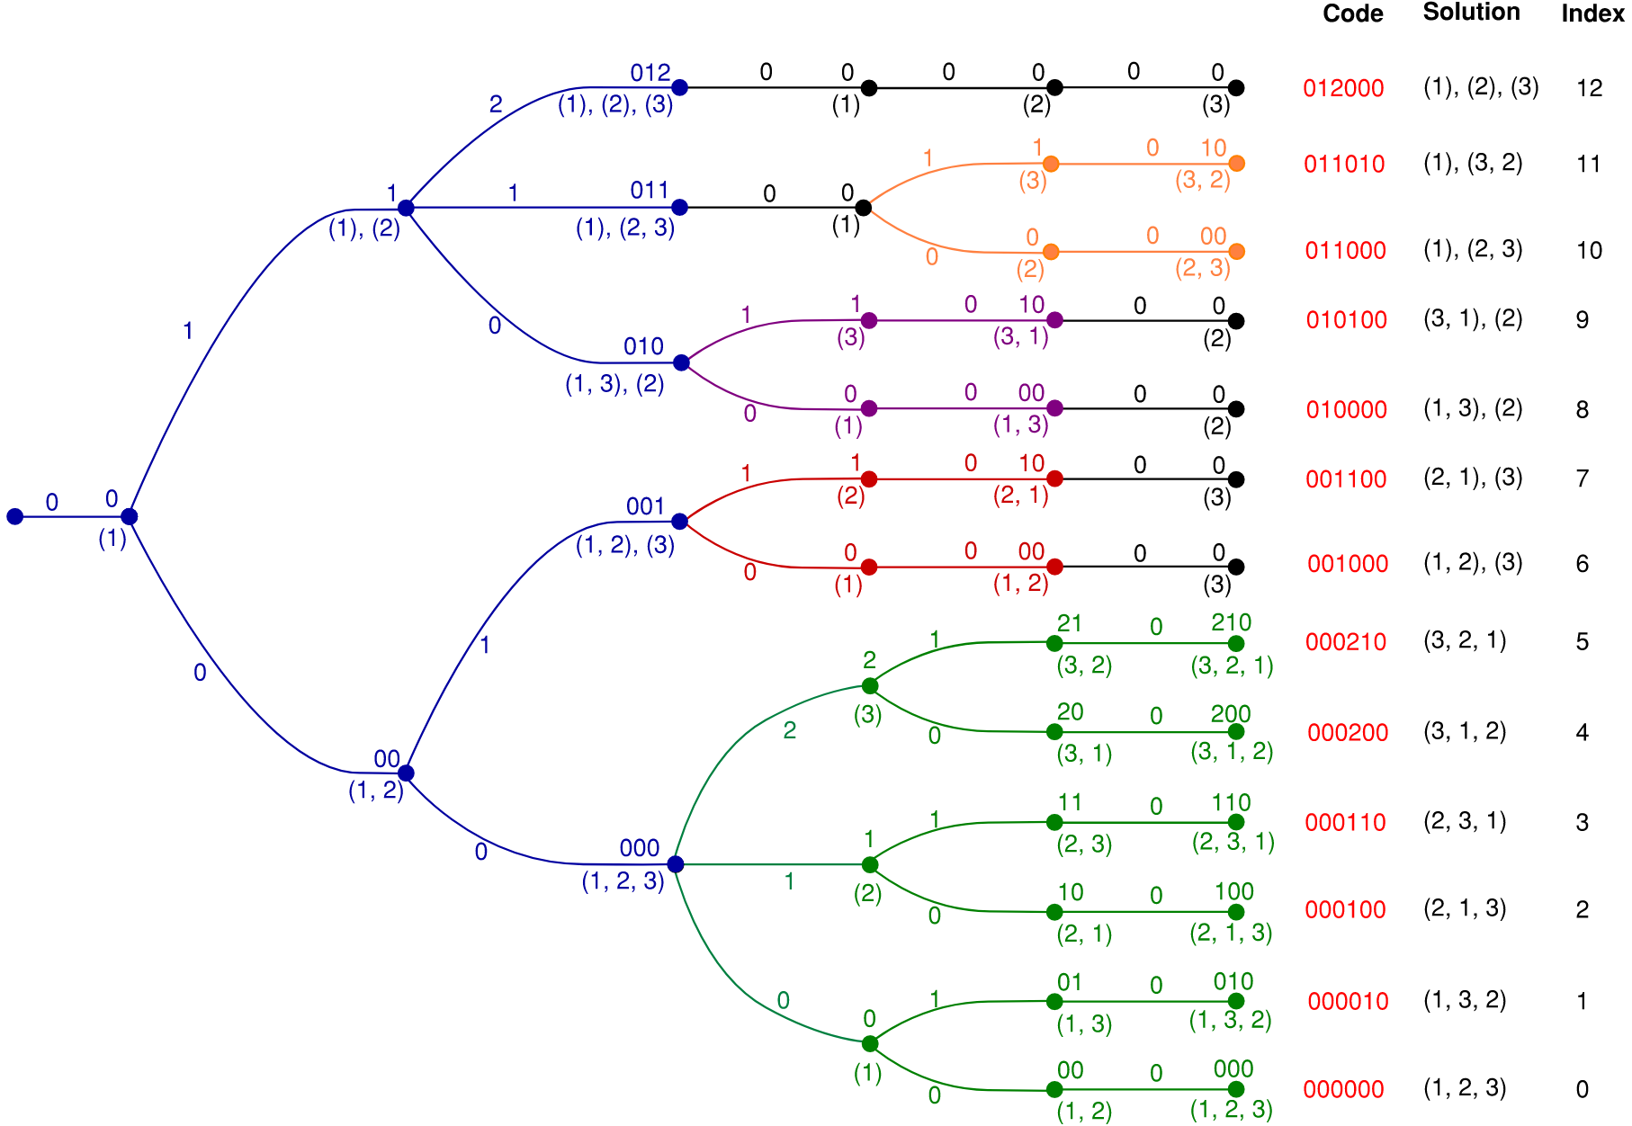
Complete Tree
Notes:
Bringing this altogether, we can see how we end up with an indexed solution space for the 3 node problem from earlier.
The partition tree occurs first, shown in blue, then from each of the resulting partitions we have the combined permutation trees.
Note that a permutation tree for a subset containing only one element consists of just a single branch, these are shown in black
Before we address the indexing of any arbitrary solution, we should first discuss how we navigate indexing with the partition and permutation trees.

Slide 9
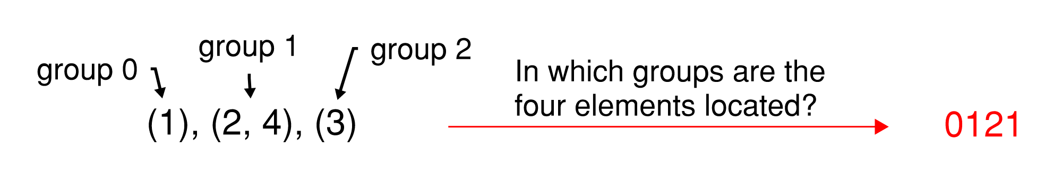
Converting a Partition to a Partition Code
Notes:
Before we can index a partition, we must convert it to its partition code.
The process is quite simple, we just ask of each of the elements, which group they are located. We do this in order from element 1 onwards.
The example shown here should demonstrate the process.

Slide 10
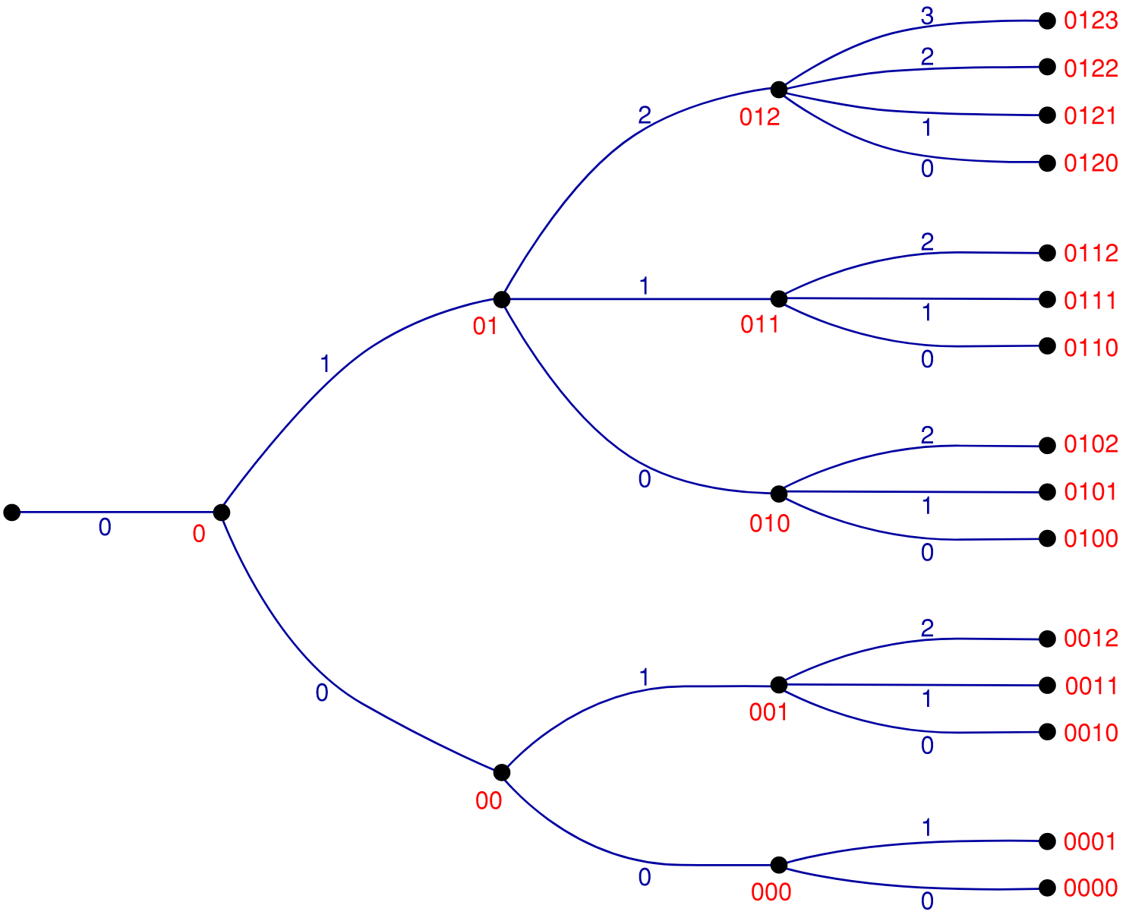
Indexing Partitions
Key Structural Features
Final digit of the code = number of nodes below it in the same group
Max digit of the code + 2 = the number of branches downstream of the node.
Indexing Algorithm
Add the number of end points for all nodes below the current node, within the same group.
Step to the next node upstream
Repeat the above and terminate at the origin
Notes:
There are two key structural features of the partition tree which allow us to create an indexing algorithm:
The final digit of the partition code for any particular node tells us the number of nodes below it, within the same group.
This may be a little obvious as it’s just a result of the branch numbering from zero upwards, with the final digit being the number of the upstream branch
The max digit of the code + 2 gives the number of branches downstream of the node.
This is a little more subtle, but the max number, eg 2 indicates that prior to this point, an element was added to the 3rd group (that labelled with a 2) and hence in the next decision we could place an element in any of these existing groups or into a new group.
In other words, the max digit + 1 is the number of existing groups and the number of existing groups + 1 is the number of choices available when appending the next element to the partition
Some definitions:
Upstream is leftwards, towards the origin. Downstream is rightwards, away from the origin and towards the outer extents of the tree.
Depth, the number of branches away from the origin / number of decisions made / length of the code
Endpoints: those nodes which are at max depth, i.e. at the outer edge of the tree.
The number of endpoints for a given node, is the number of max depth nodes which occur downstream from that node. Or in other words, the number of downstream partitions
The algorithm:
Add the number of endpoints for all nodes below the current node (within the same group). In other words: take the final digit of the code, iterate down to zero, adding the number of endpoints for each resulting code.
step up the tree to the previous node or in other words: remove last digit of the code
repeat the previous steps until you reach the origin (or until there are no more digits in the code)
Calculating the number of endpoints for a node is a recursive function:
You append the next possible digits to the code, and add the endpoints for each of these new codes.
The recursion terminates with a return of 1 when a code is at max depth.

Slide 11
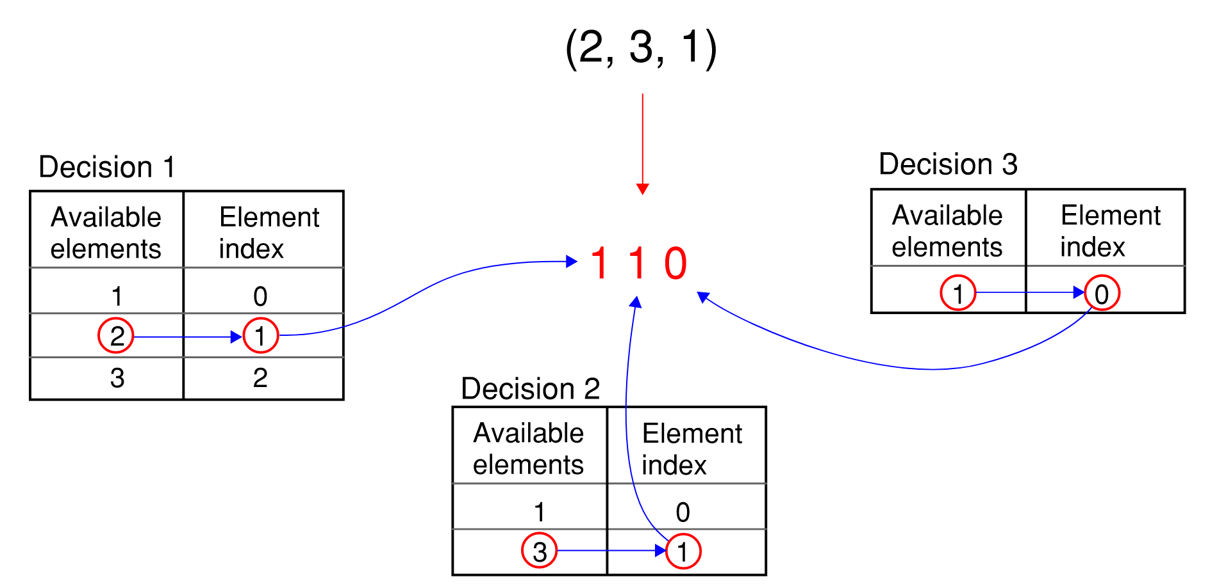
Converting a Permutation to a Permutation Code

Slide 12
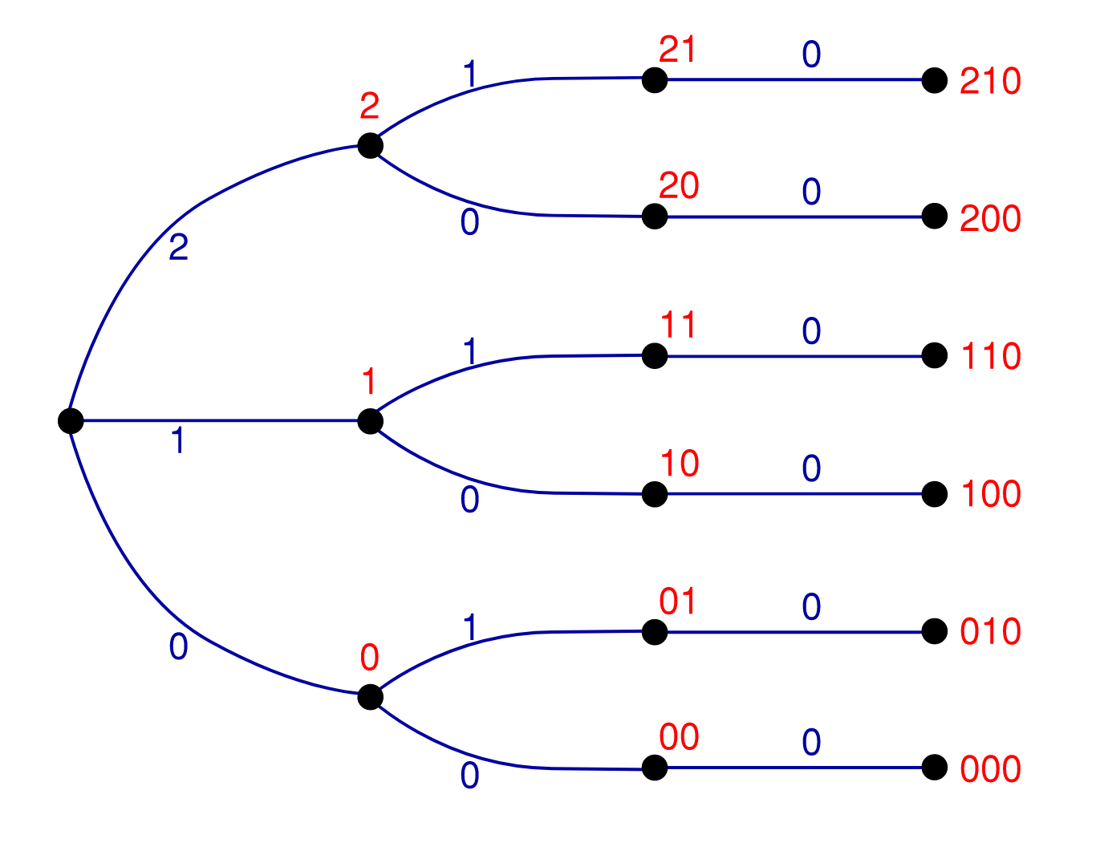
Indexing Permutations
Key Structural Features
Final digit of the code = number of nodes below it in the same group
The number of endpoints downstream of a particular node is equal to the factorial of the difference between its depth and the max depth.
Indexing Algorithm
Add the number of end points for all nodes below the current node, within the same group
Step to the next node upstream
Repeat the above and terminate at the origin
Notes:
The first key structural feature of the permutation tree is the same as for the partition tree, the final digit of a code tells you how many nodes sit below the current node, within the same group.
The second key feature is that the number of endpoints downstream of a particular node is equal to the factorial of the difference between the depth at that node and the max node.
The Algorithm is the same as for the partition tree, except determining the number of endpoints downstream of a particular node is a simple computation rather than a recursive one.

Slide 13
Indexing Combined Permutations
Index((3, 1, 7), (6, 2), (5, 8, 4))
= Index((3, 1, 7)) * 2! * 3!
+ Index((6, 2)) * 3!
+ Index((5, 4, 8))
Notes:
The method for finding the index of a combined permutation is perhaps best explained by an example.
The intuition behind this is roughly as follows:
Recall the nested nature of the combined permutation tree. There is one permutation tree for the (3, 1, 7) subset, and off each of the 3! endpoints of this tree there exists entire permutation trees of the (6, 2) subset, at the 2! endpoints of each of these trees exist entire permutations trees of the (5, 4, 8) subset.
As such, for every permutation of the (3, 1, 7) subset that we step past, we skip a total of 2! * 3! endpoints. That is why this index is amplified as such. The same goes for the index of the (6, 2) subset, where this time each skipped permutation only has 3! endpoints downstream of it. finally we get to the (5, 4, 8) subset. These permutation trees sit on the outer extents of the combined permutation tree, their endpoints are where the tree terminates, so no need to amplify this index. Skipping past a permutation here equates to only a single endpoint on the tree.

Slide 14
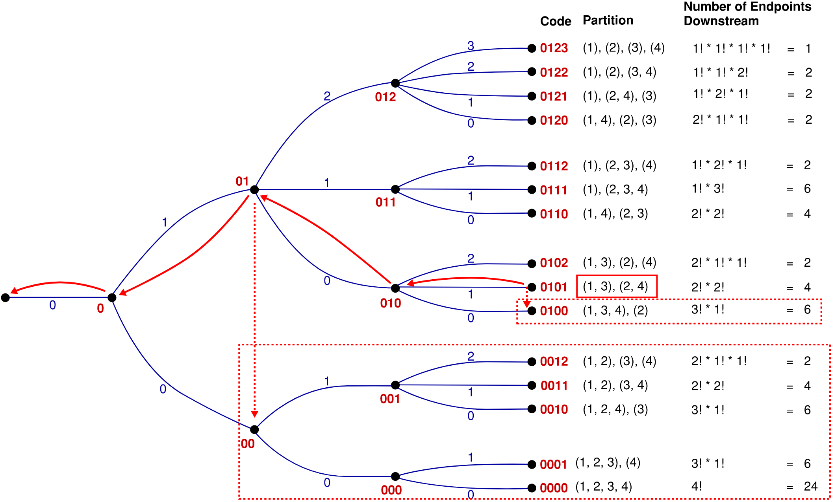
Indexing Solutions
Index((3,1), (2,4)) = Index((3,1)) * 2!
+ Index((2,4))
+ (6)
+ (2 + 4 + 6 + 6 + 24)
= 1*2 + 0 + 6 + 42
= 50
Notes:
So, bringing it all together now, and Indexing a solution from the full solution space.
The partition tree algorithm remains the same, however, the number of endpoints downstream of the nodes at max depth is not just 1 anymore, but instead is the combined factorial. ( which is the number of combined permutations for a given partition)
We begin by computing the index of the combined permutation, then add continue with the partition algorithm as previously described.
The example shown here is finding the index of the solution: (3, 1), (2, 4).
Unindexing
The un-indexing algorithm follows quite naturally from all of this, so instead of spending any real time on it, let's imagine going in the opposite direction. Say you want the solution with index 50 - this means you want the solution that has 50 others below it on the tree.
(talk through the process)
Side Note:
We know that the max index solution will always be that single solution at the top of the partition tree, where all elements are in separate groups. using this we can determine for example that the 14 node problem has 3.5 x 10^12 solutions, without having to first generate the solution space. In fact I was able to compute this on my surface pro.
this number is about 40 times bigger than 14 factorial, so this problem grows very quickly

Slide 15
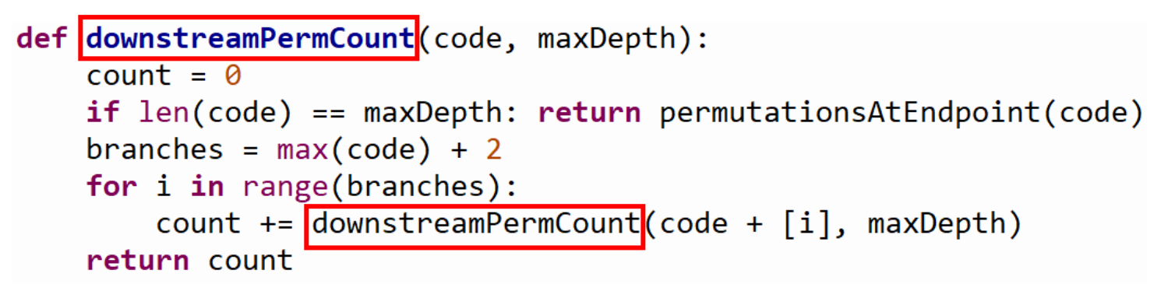
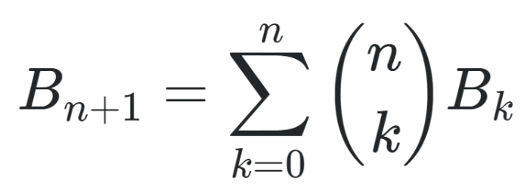
Recursion concern
Notes:
The indexing and unindexing needs to be efficiently computable on a quantum circuit.
However, the current algorithm to navigate the partition tree contains recursion, which you can see in the snippet of code shown here. The code calculates the number of solutions or permutations downstream of any node in the partition tree. And currently the code visits each of downstream nodes in the partition tree
The number of possible partitions for a set containing n elements is known as the nth bell number. And you can see here the equation for bell numbers which is often given in this recursive form. Bell numbers grows exponentially, so an algorithm which visits each node will not be efficient enough at large n.
As such, the indexing algorithm requires more attention. Perhaps by investigating the structure of the partition tree more closer we might be able to find a more efficient way to count downstream solutions. Though I suspect this will be a challenging problem.

Slide 16
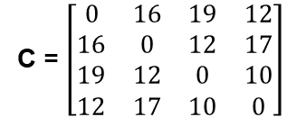
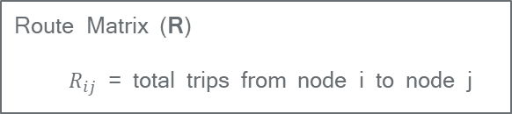
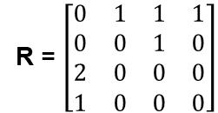
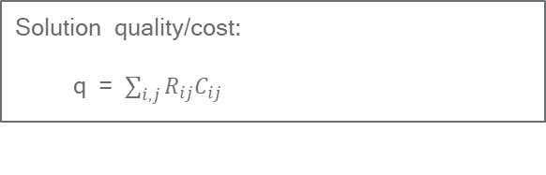
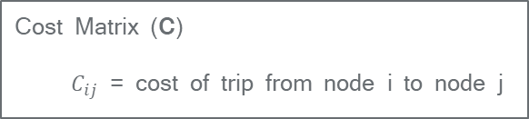
Route Matrix and Costing
Route Matrix (R)
$R_{ij}$ = total trips from node i to node j
Example from earlier: (1, 2), (3)
R = $\left[\begin{matrix}0 & 1 & 1 & 1 \\ 0 & 0 & 1 & 0 \\ 2 & 0 & 0 & 0 \\ 1 & 0 & 0 & 0\end{matrix}\right]$
Cost Matrix (C)
$C_{ij}$ = cost of trip from node i to node j
C = $\left[\begin{matrix}0 & 16 & 19 & 12 \\ 16 & 0 & 12 & 17 \\ 19 & 12 & 0 & 10 \\ 12 & 17 & 10 & 0\end{matrix}\right]$
Solution quality/cost:
q = $\sum_{i,j}{R_{ij}C_{ij}}$
q = 1(16) + 1(19) + 1(12) + 1(12) + 2(19) + 1(12) = 109
Notes:
Now that we have established our solution space, we need to be able to assess the quality of each solution.
For this purpose I’ve introduced a Route Matrix. It’s quite simple really, the route matrix just tracks the number of times any particular route is taken between any two nodes.
The quality of a solution can then be assessed by simply summing the product of corresponding elements in the route and cost matrices.
To illustrate this I’ve shown the costing of the example solution we looked at earlier.
Note that although the cost matrix for this example was symmetrical, it does not need to be. There might be reasons why a route in one direction is more costly than in the reverse direction, e.g. differences in traffic, differences in elevation, etc. The Route matrix allows for this by differentiating between the route directions.

Slide 17
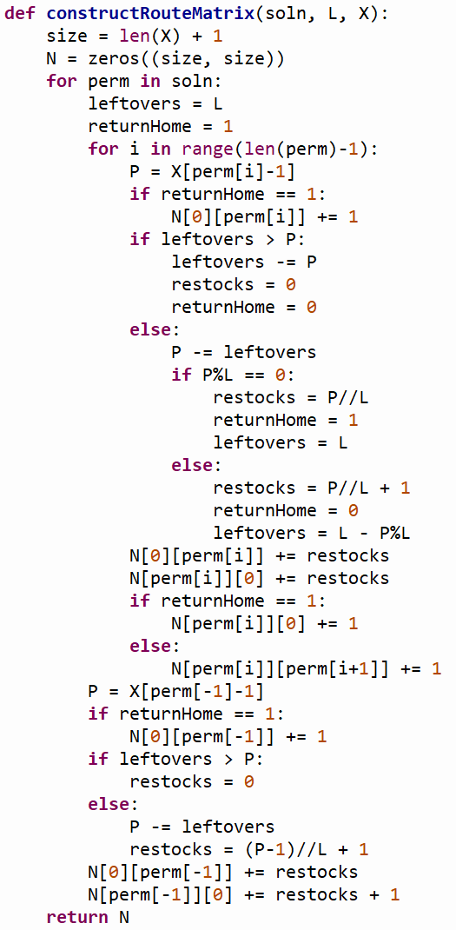
Constructing the Route Matrix
Notes:
As you can probably see, the code I’ve written to construct the route matrix is full of conditional logic (if else statements).
The construction of the route matrix depends on the number of packages required at each location as well as the capacity of the vehicles.
It’s so situation dependent that I believe this is the only way to approach the problem.
This process grows linearly with increasing n, so I believe it should be efficiently computable on a quantum circuit.

Slide 18
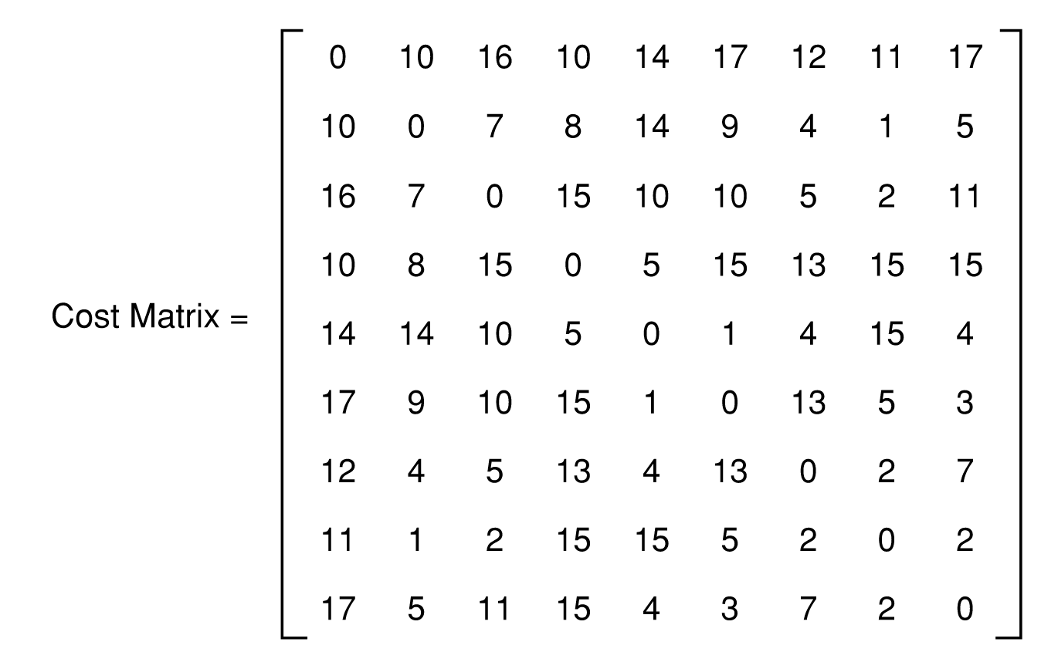
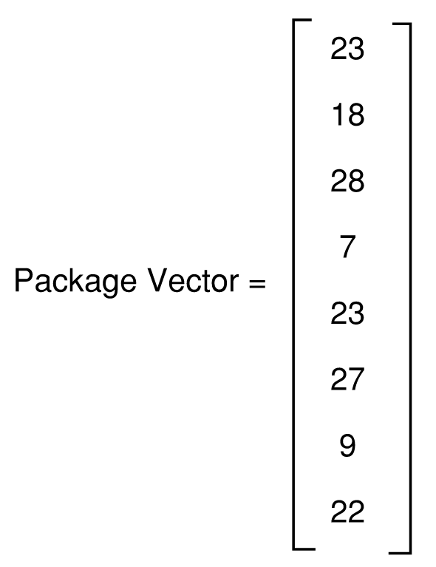
8 –Node Problem
Notes:
To get a feel for how the solution qualities are distributed, we’ll look at a randomly generated 8 node problem.
This problem, and in fact any arbitrary 8-node problem, has just under 400,000 unique solutions. When we plot the distribution of these solution qualities we see it looks like it approximates a normal distribution.

Slide 19
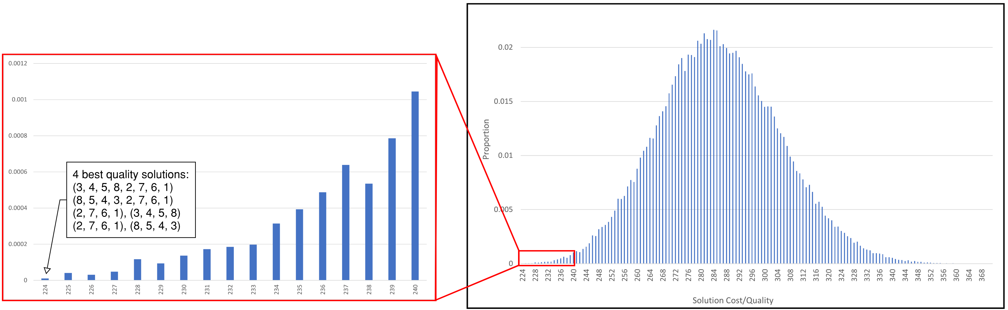
8 –Node Problem
Notes:
As you can see by the magnification on the left, the highest quality solutions represent a tiny part of the initial distribution of solution qualities.
This is where the QWOA comes into play. We start with an equal superposition of all 400,000 states, indexed according to our previously described algorithm, and we hope to amplify the probability of measuring the system in one of the highest quality states.

Slide 20
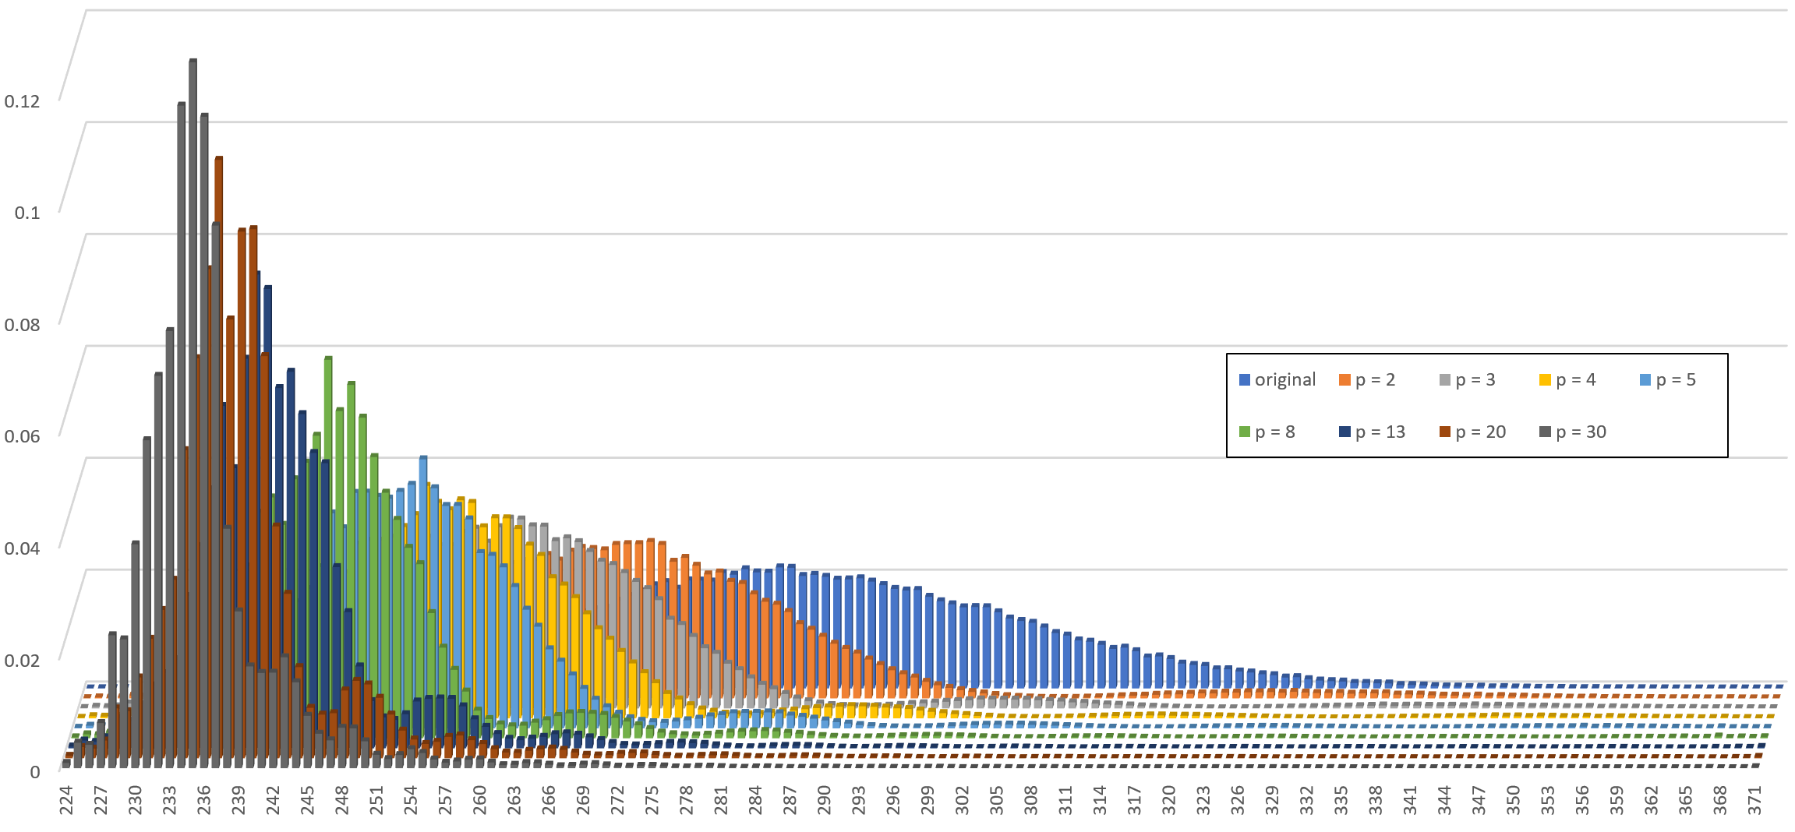
Results
Notes:
Special thanks to Edric for helping me to learn my way around his QWOA program.
These are some of the results from the simulations run on the magnus supercomputer at Pawsey.
At first glance it looks great, we are massively amplifying the probability of measuring the system in one of the higher quality states. This is even more true than upon initial inspection, because, if you’ll remember, this amplified range is home to only a very small proportion of the total solution space.
However, the results are not as good as I personally had hoped. I’m sure if we continued with higher p, we could see an even stronger spike at the far end, but we’re already pushing to p = 30. I had hoped to see these results at much lower p values.
Perhaps it’s not surprising though, the solution space consists of a massive proportion of mid tier solutions, and only a very small proportion of higher quality solutions, so the algorithm is in a sense fighting an up hill battle.
Side note: I thought it was pretty cool to see these secondary structures. Very quantum like behaviour.

Slide 21
Next Steps
More efficient Indexing Algorithm
Higher convergence at lower p

Slide 22
THANKS!
Do you have any questions?
tavis.d.bennett@gmail.com

